Slide 1
Architecture of Enterprise Applications 1 Overview of Enterprise Applications
Haopeng Chen
REliable, INtelligent and Scalable Systems Group (REINS)
Shanghai Jiao Tong University
Shanghai, China
http://reins.se.sjtu.edu.cn/~chenhp
e-mail: chen-hp@sjtu.edu.cn

Slide 2
Contents and Objectives
Contents
Architecture (架构)
Scope
Objectives
能够根据应用系统的规模，确定适合的技术路线，从单机部署到分布式集群部署，再到微服务架构和云部署
能够根据系统需求，设计并实现由合理的有状态服务与无状态服务构成服务层

Slide 3
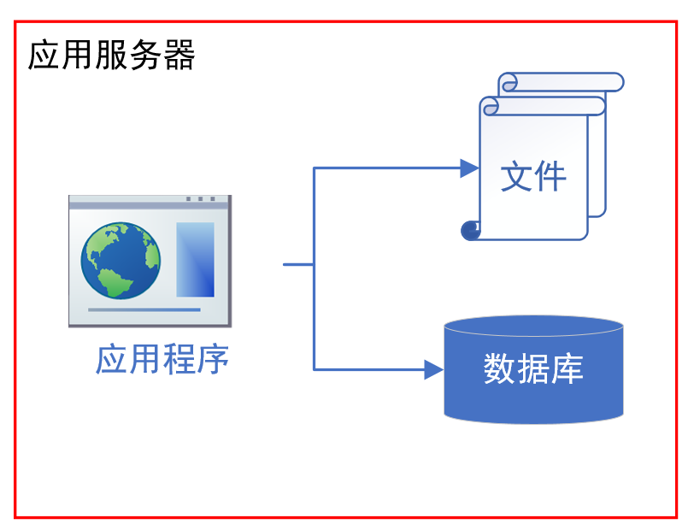
Architecture of Java Web Application

Slide 4
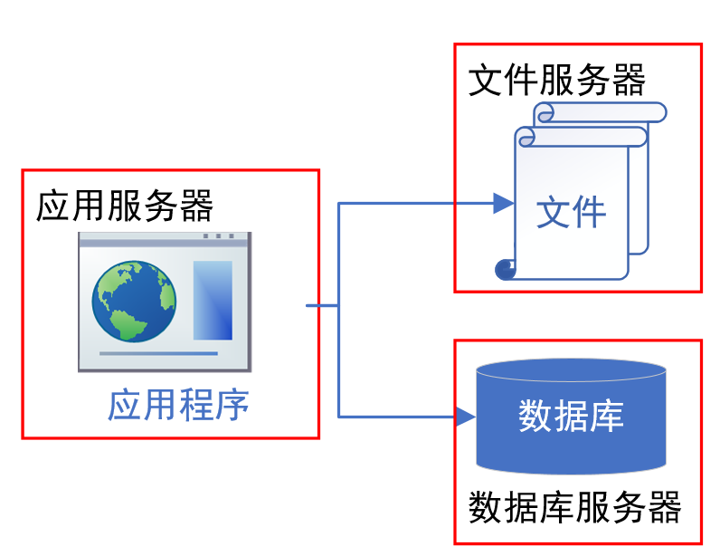
Architecture of Java Web Application
将系统的不同功能部分分布到不同服务器上面

Slide 5
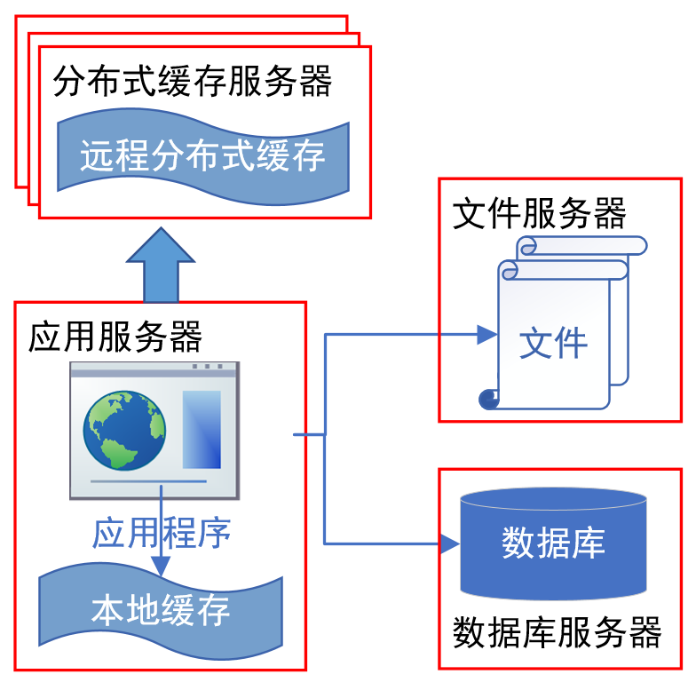
Architecture of Java Web Application

Slide 6
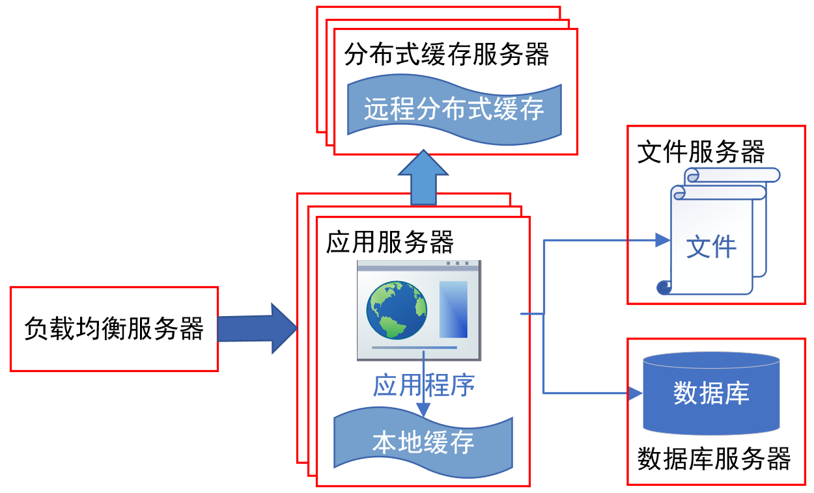
Architecture of Java Web Application

Slide 7
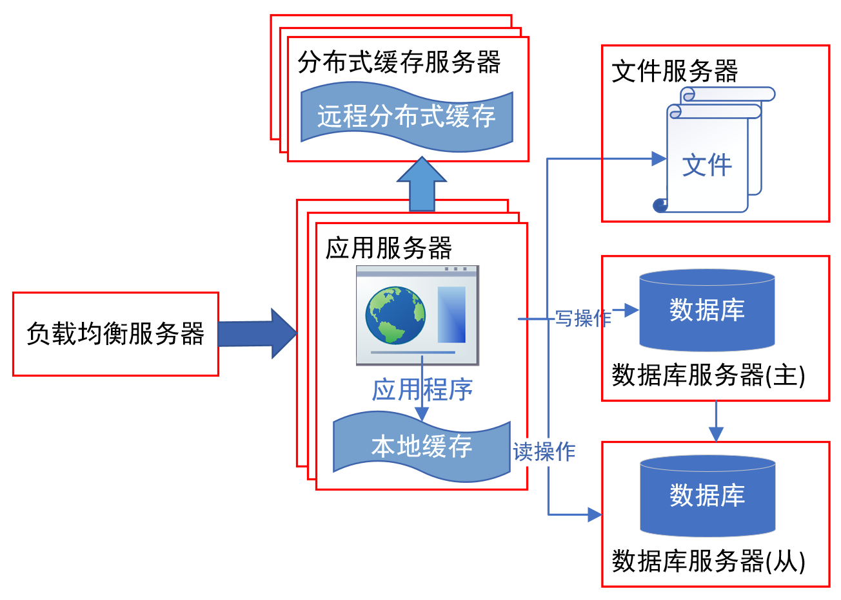
Architecture of Java Web Application

Slide 8
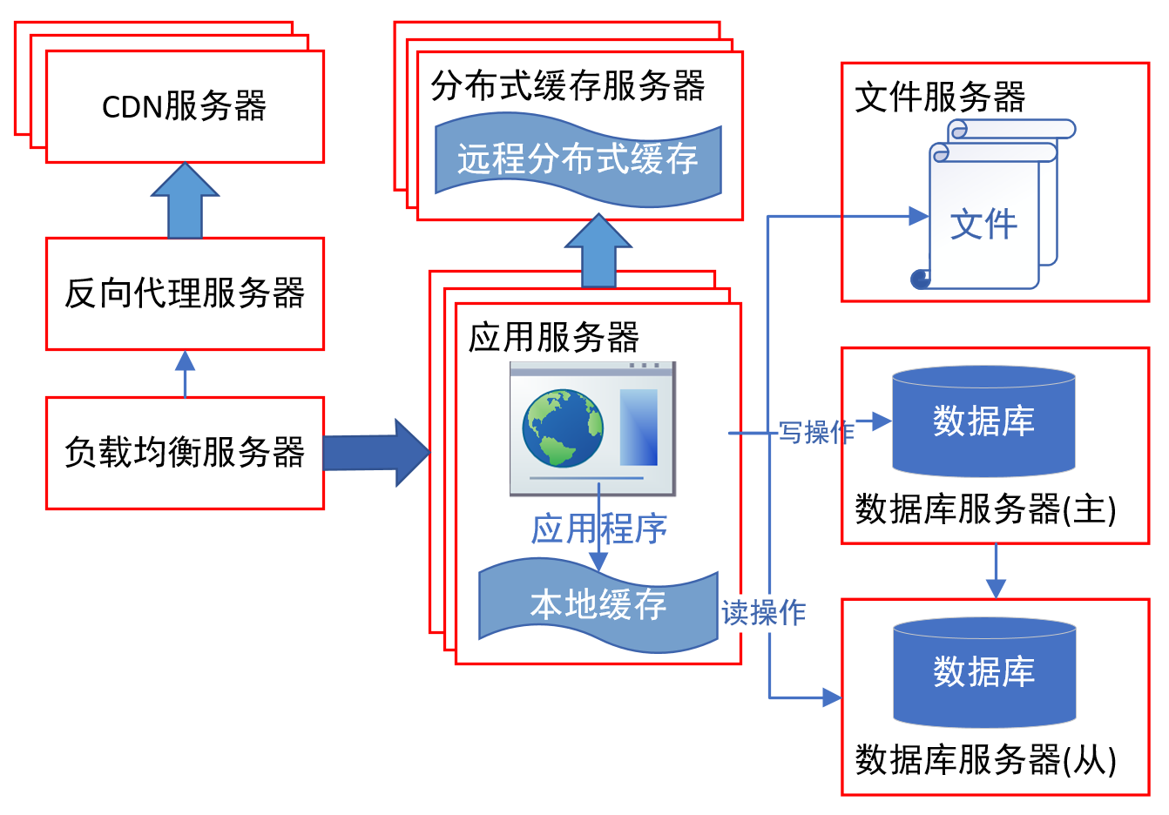
Architecture of Java Web Application

Slide 9
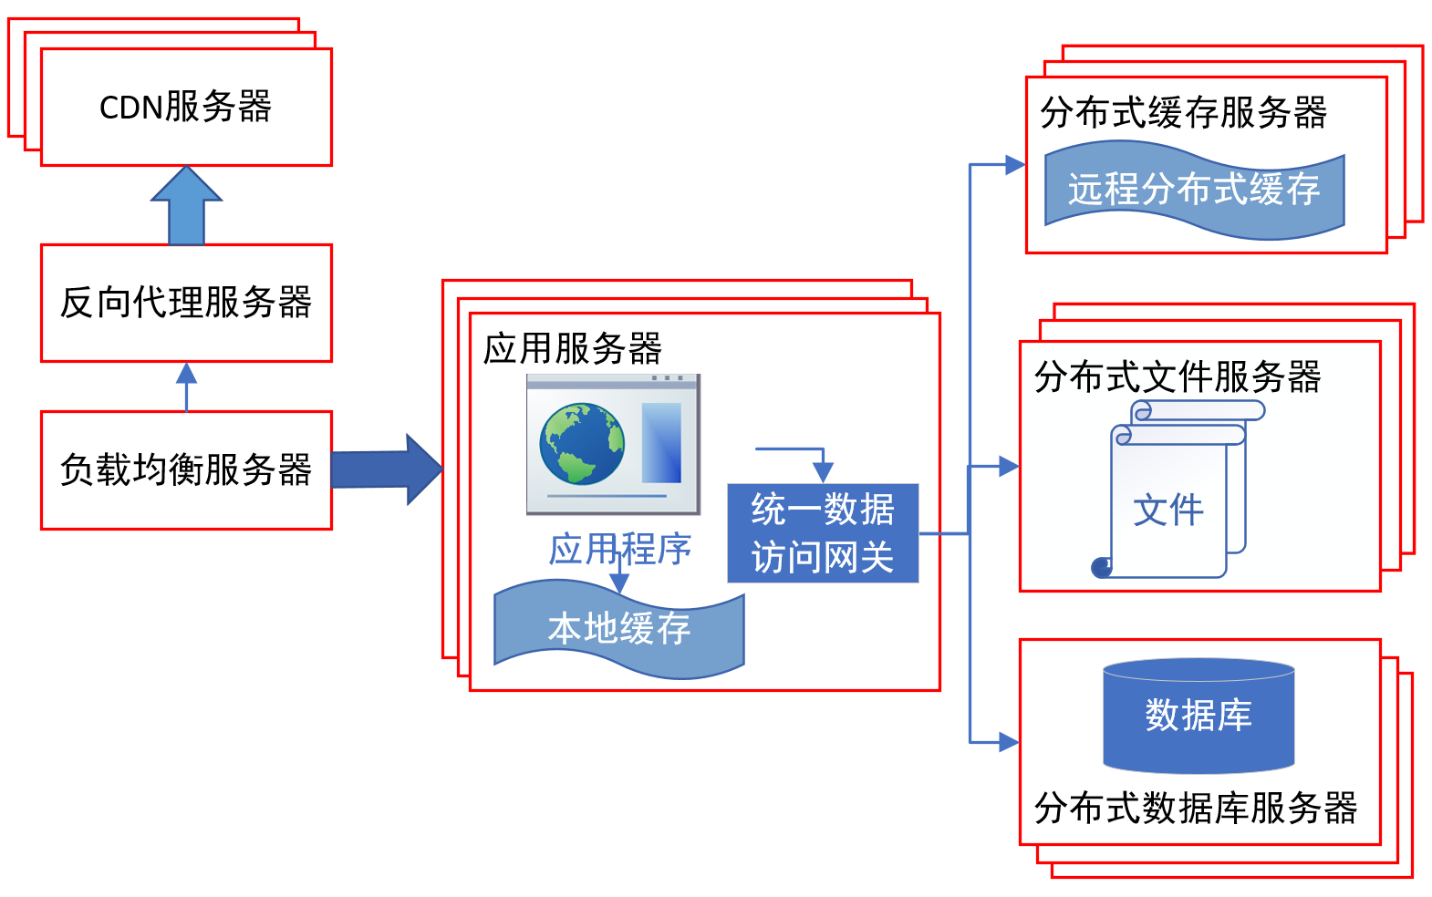
Architecture of Java Web Application

Slide 10
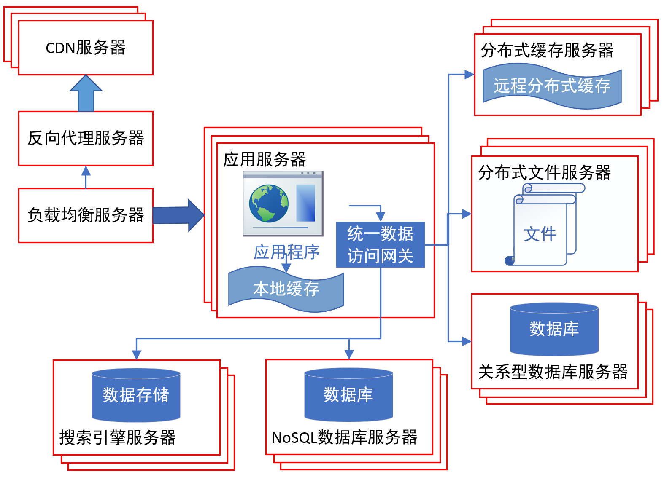
Architecture of Java Web Application

Slide 11
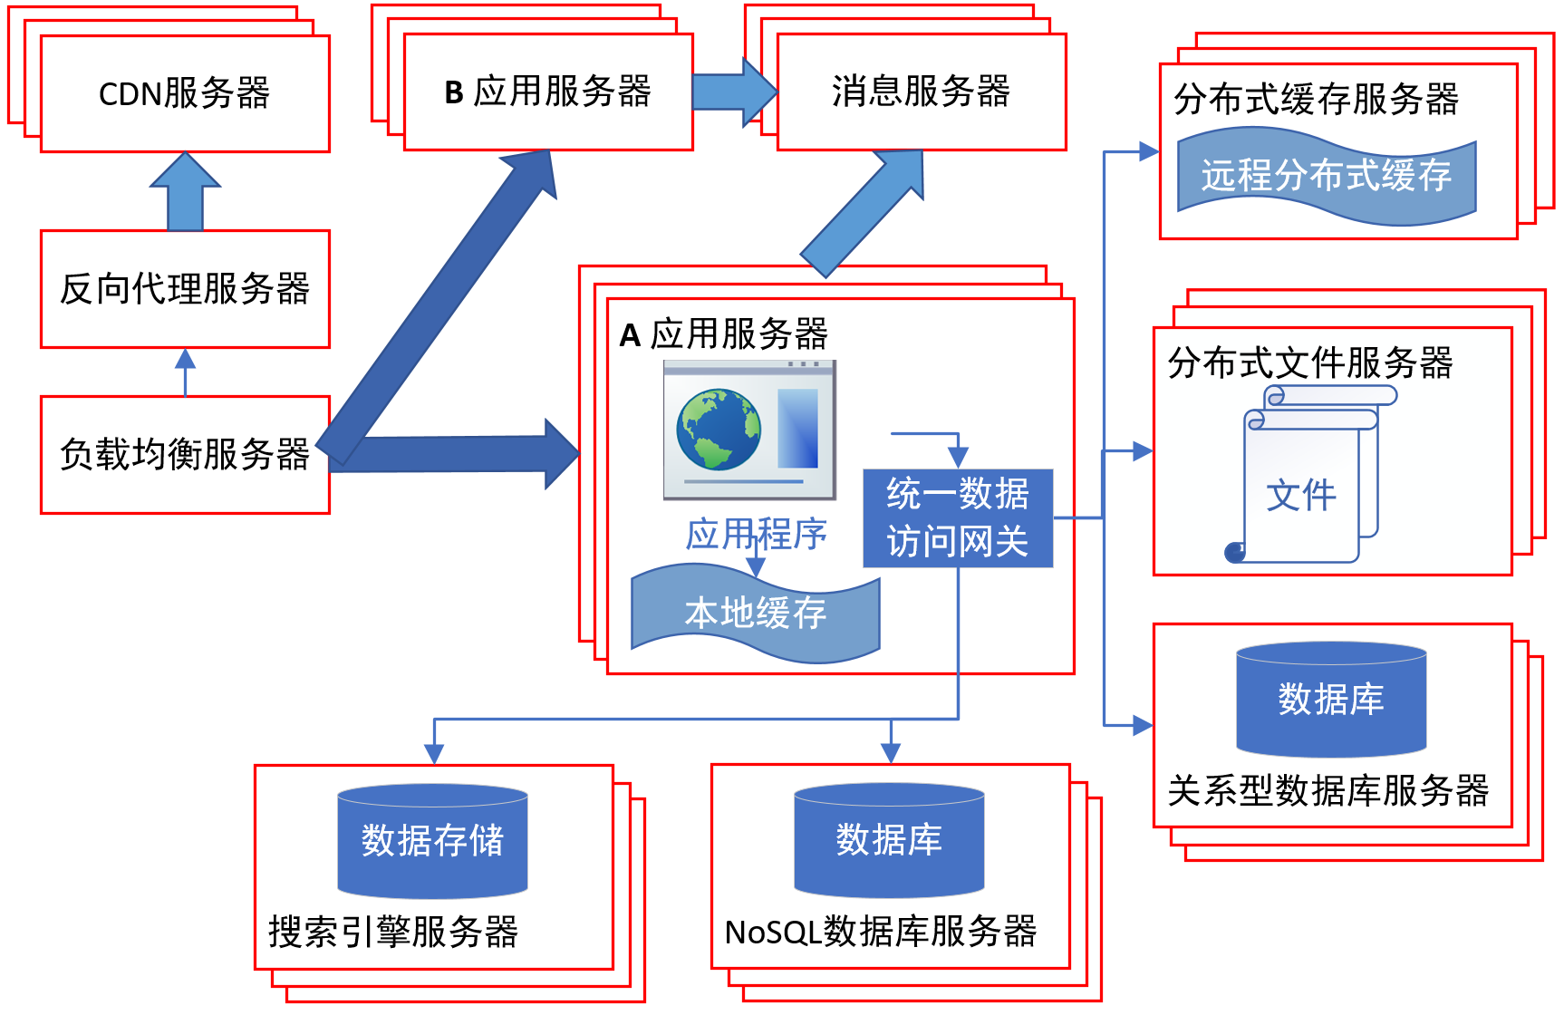
Architecture of Java Web Application

Slide 12
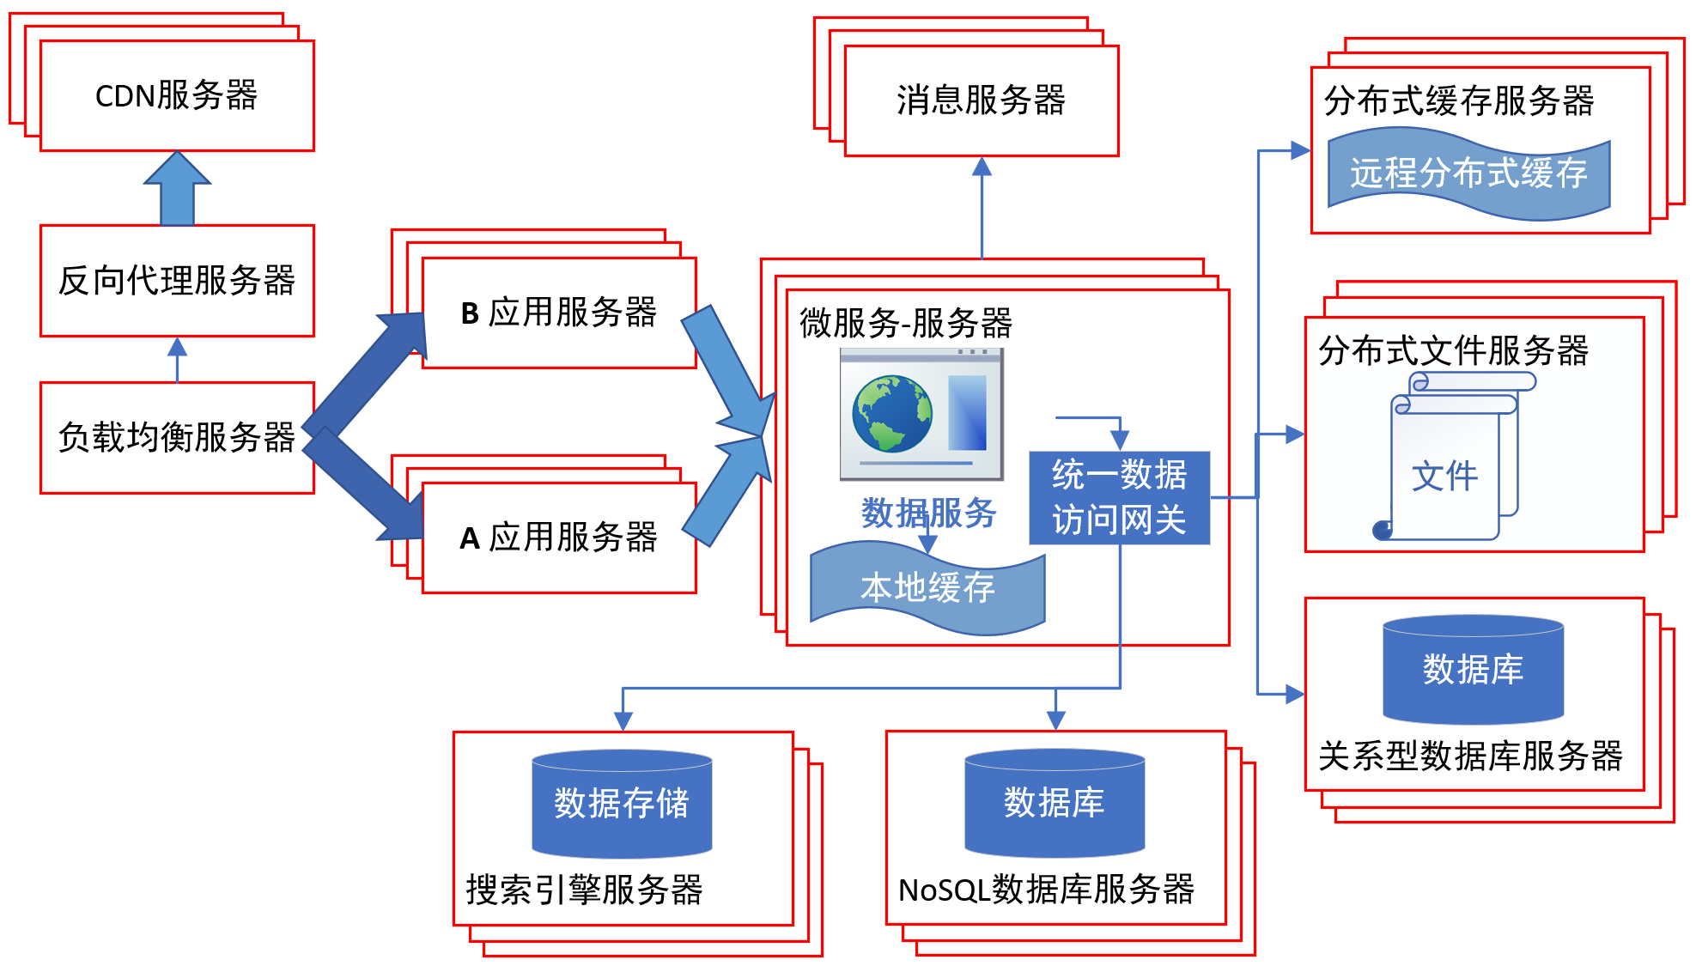
Architecture of Java Web Application

Slide 13
Architecture of Enterprise Applications 1 Stateful and Stateless Services
Haopeng Chen
REliable, INtelligent and Scalable Systems Group (REINS)
Shanghai Jiao Tong University
Shanghai, China
http://reins.se.sjtu.edu.cn/~chenhp
e-mail: chen-hp@sjtu.edu.cn

Slide 14
Recall: HTTP session state
HTTP is a stateless protocol
A stateless protocol does not require the HTTP server to retain information or status about each user for the duration of multiple requests.
from: https://www.openhome.cc/Gossip/ServletJSP/BehindHttpSession.html

Slide 15
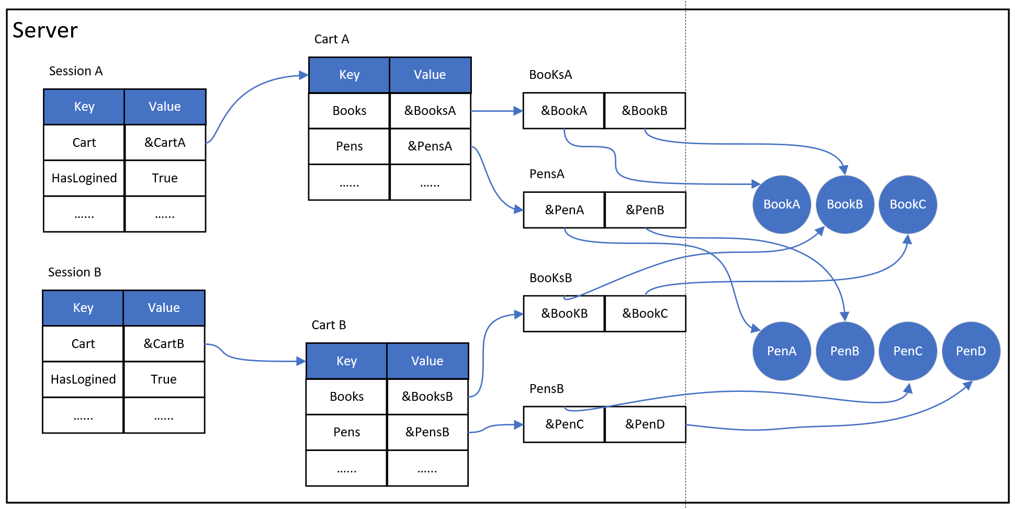
Recall: HTTP session state
HTTP is a stateless protocol

Slide 16
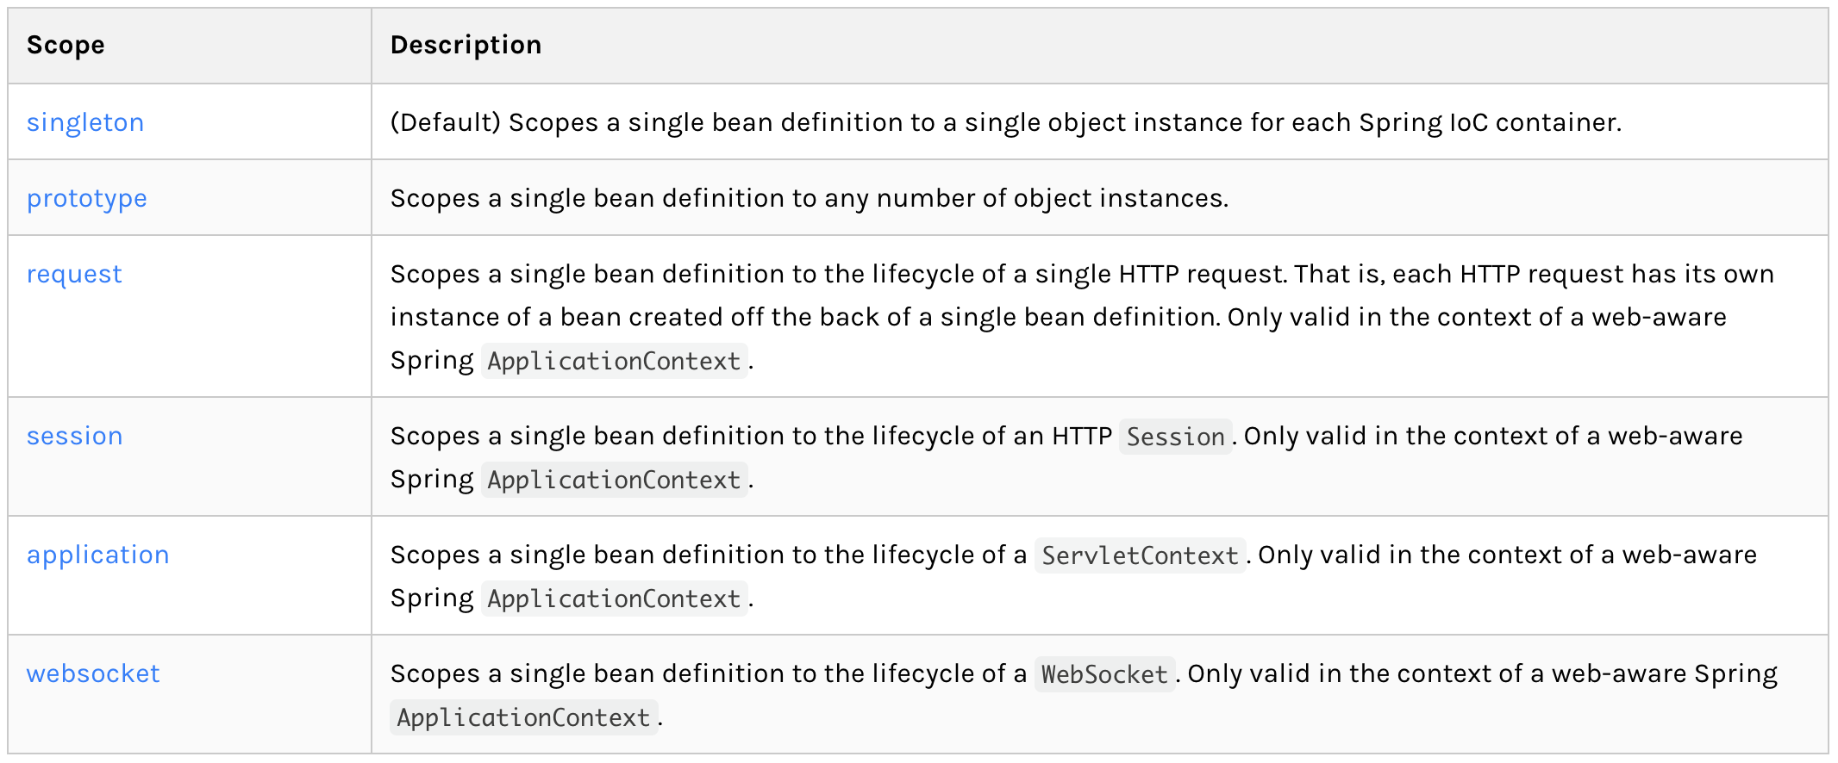
Spring Bean Scopes
What’s the meaning of scope?

Slide 17
Scope
Singleton : Stateless

Slide 18
Scope
Prototype : Stateful

Slide 19
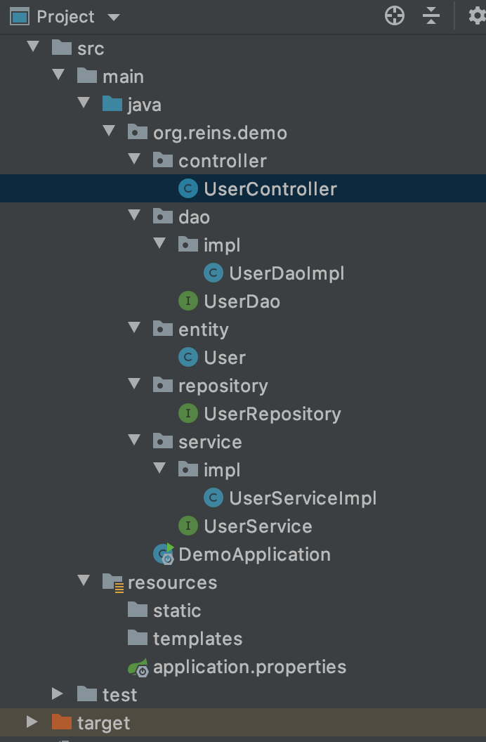
Default Scope - singleton
UserController.java
@RestController public class UserController { @Autowired private UserService userService; @GetMapping(value = "/findUser/{id}") public User findOne(@PathVariable("id") String id) { System.out.println(userService); return userService.findUserById(Integer.valueOf(id)); }; }
UserServiceImpl.java
@Service public class UserServiceImpl implements UserService { @Autowired private UserDao userDao; @Override public User findUserById(Integer id) { return userDao.findOne(id); } }

Slide 20
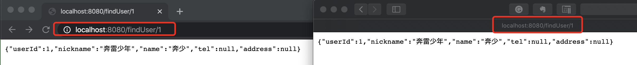
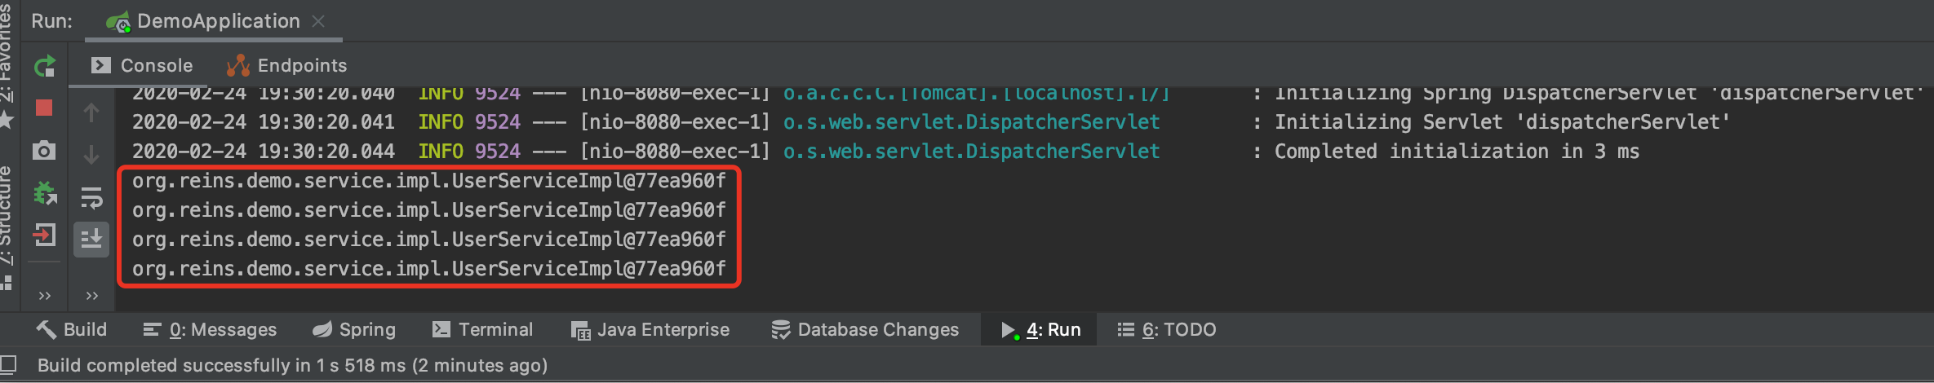
Default Scope - singleton
Single Service instance

Slide 21
Scope - prototype
这里仍然是single，是因为
scope是声明在service层的，
而HTTP本身是singleton的，即
controller仍然只会有一个instance，
因而在注入userService时只会注入
一个，故输出还是相同的。
UserController.java
@RestController public class UserController { @Autowired private UserService userService; @GetMapping(value = "/findUser/{id}") public User findOne(@PathVariable("id") String id) { System.out.println(userService); return userService.findUserById(Integer.valueOf(id)); }; }
UserServiceImpl.java
@Service @Scope("prototype") public class UserServiceImpl implements UserService { @Autowired private UserDao userDao; @Override public User findUserById(Integer id) { return userDao.findOne(id); } }
prototype

Slide 22
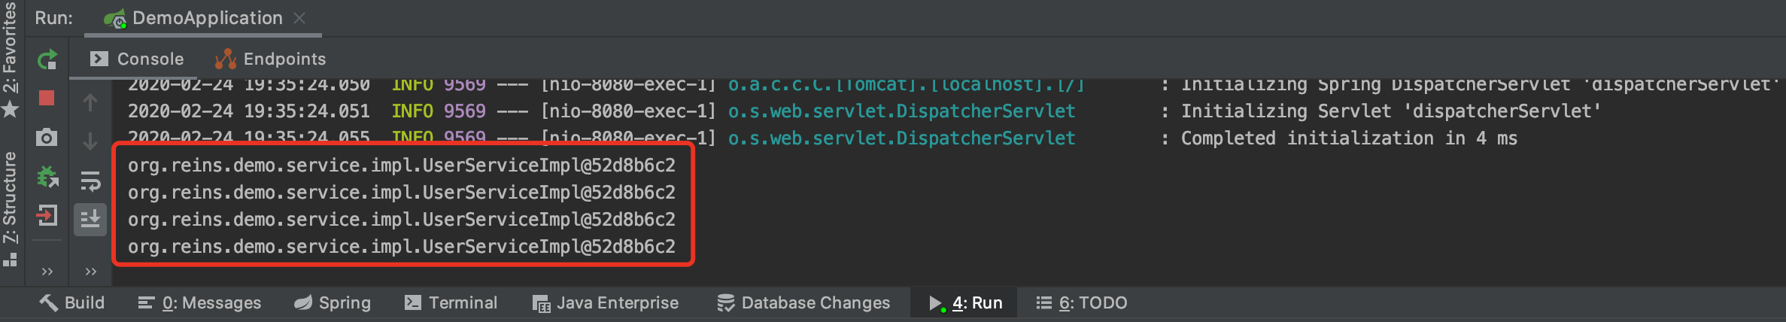
Scope - prototype
Still Single. Why?

Slide 23
Scope - prototype
UserController.java
@RestController
@Scope("prototype") public class UserController { @Autowired private UserService userService; @GetMapping(value = "/findUser/{id}") public User findOne(@PathVariable("id") String id) { System.out.println(userService); return userService.findUserById(Integer.valueOf(id)); }; }
prototype
UserServiceImpl.java
@Service @Scope("prototype") public class UserServiceImpl implements UserService { @Autowired private UserDao userDao; @Override public User findUserById(Integer id) { return userDao.findOne(id); } }
prototype

Slide 24
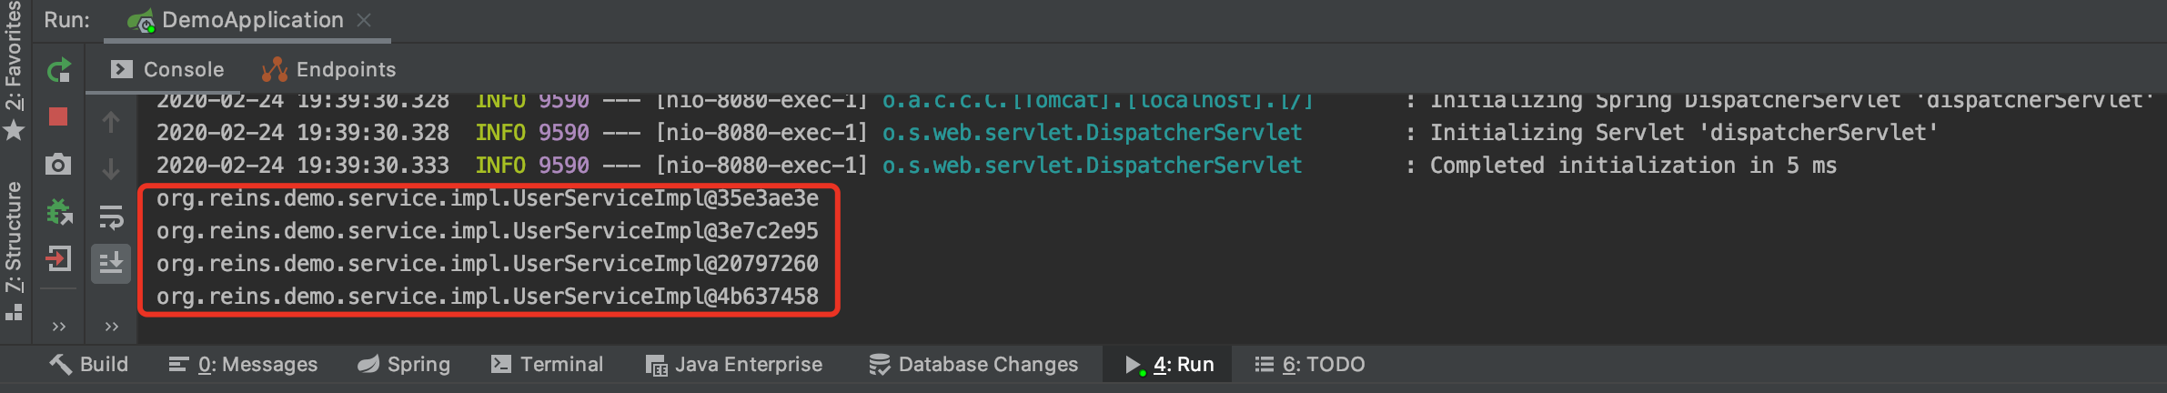
Scope - prototype
因为最好的是有四个不同的service，
然后有1或者2个controller
Now different. But not good!

Slide 25
Scope - prototype
UserController.java
@RestController public class UserController { @Autowired WebApplicationContext applicationContext; @GetMapping(value = "/findUser/{id}") public User findOne(@PathVariable("id") String id) { UserService userService = applicationContext.getBean(UserService.class); System.out.println(userService); return userService.findUserById(Integer.valueOf(id)); }; }
WebApplicationContext
UserService
UserServiceImpl.java
@Service @Scope("prototype") public class UserServiceImpl implements UserService { @Autowired private UserDao userDao; @Override public User findUserById(Integer id) { return userDao.findOne(id); } }
prototype

Slide 26
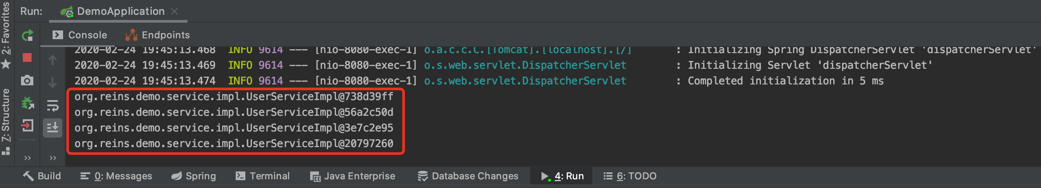
Scope - prototype
Now different. Why is this solution better?
只有一个controller

Slide 27
Scope - session
UserController.java
@RestController public class UserController { @Autowired WebApplicationContext applicationContext; @GetMapping(value = "/findUser/{id}") public User findOne(@PathVariable("id") String id) { UserService userService = applicationContext.getBean(UserService.class); System.out.println(userService); return userService.findUserById(Integer.valueOf(id)); }; }
WebApplicationContext
UserService
UserServiceImpl.java
@Service @Scope(”session") public class UserServiceImpl implements UserService { @Autowired private UserDao userDao; @Override public User findUserById(Integer id) { return userDao.findOne(id); } }
session

Slide 28
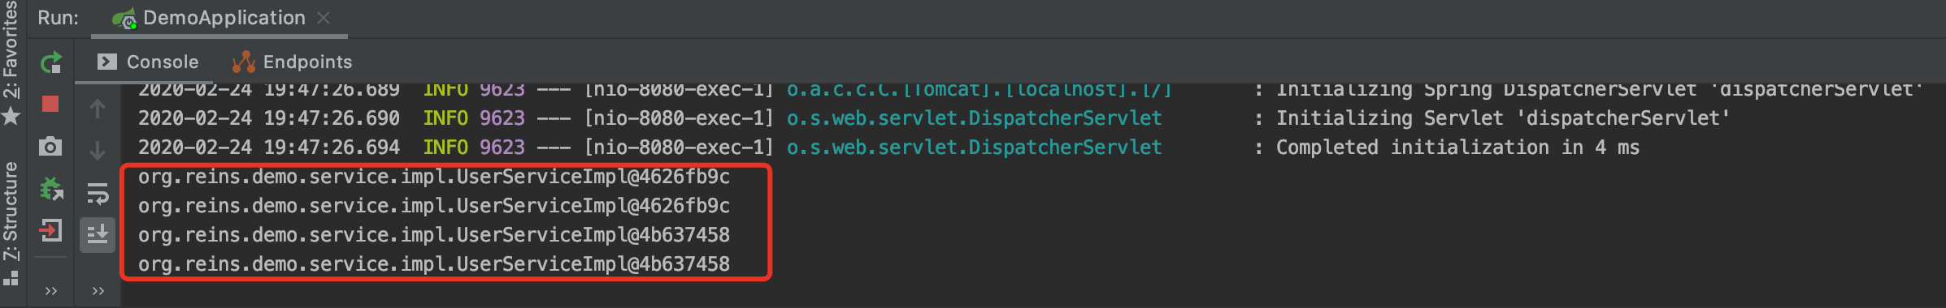
Scope - session
Two Service instances

Slide 29
Scope - session
UserController.java
@RestController
@Scope(”session") public class UserController { @Autowired WebApplicationContext applicationContext; @GetMapping(value = "/findUser/{id}") public User findOne(@PathVariable("id") String id) { UserService userService = applicationContext.getBean(UserService.class); System.out.println(userService);
System.out.println(this); return userService.findUserById(Integer.valueOf(id)); }; }
session
WebApplicationContext
UserService
this
UserServiceImpl.java
@Service @Scope(”prototype") public class UserServiceImpl implements UserService { @Autowired private UserDao userDao; @Override public User findUserById(Integer id) { return userDao.findOne(id); } }
prototype

Slide 30
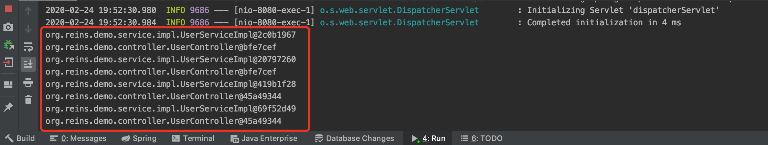
Scope - session
Two Controller instances
Four Service instances

Slide 31
Scope - session
UserController.java
@RestController
@Scope(”session") public class UserController { @Autowired WebApplicationContext applicationContext; @GetMapping(value = "/findUser/{id}") public User findOne(@PathVariable("id") String id) { UserService userService = applicationContext.getBean(UserService.class); System.out.println(userService);
System.out.println(this); return userService.findUserById(Integer.valueOf(id)); }; }
session
WebApplicationContext
UserService
this
UserServiceImpl.java
@Service @Scope(”session") public class UserServiceImpl implements UserService { @Autowired private UserDao userDao; @Override public User findUserById(Integer id) { return userDao.findOne(id); } }
session

Slide 32
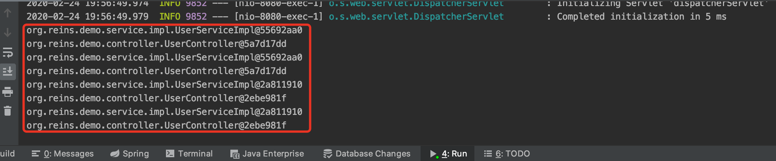
Scope - session
Two Controller instances
Two Service instances

Slide 33
Scope - session
UserController.java
@RestController
@Scope(”prototype") public class UserController { @Autowired WebApplicationContext applicationContext; @GetMapping(value = "/findUser/{id}") public User findOne(@PathVariable("id") String id) { UserService userService = applicationContext.getBean(UserService.class); System.out.println(userService);
System.out.println(this); return userService.findUserById(Integer.valueOf(id)); }; }
prototype
WebApplicationContext
UserService
this
UserServiceImpl.java
@Service @Scope(”session") public class UserServiceImpl implements UserService { @Autowired private UserDao userDao; @Override public User findUserById(Integer id) { return userDao.findOne(id); } }
session

Slide 34
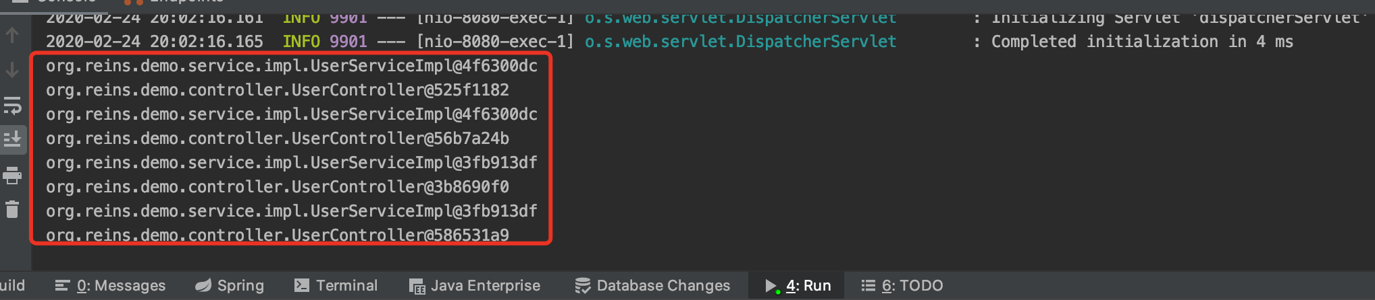
Scope - session
Four Controller instances
Two Service instances

Slide 35
Summary
2 Browsers(2 Sessions), 4 Requests( 2 times / session)
How should we design the scopes of Beans?
 |  | Controller
 |  | Prototype | session
Service | prototype | 4 service instances 4 controller instances | 4 service instances 2 controller instances
 | session | 2 service instances 4 controller instances | 2 service instances 2 controller instances

Slide 36
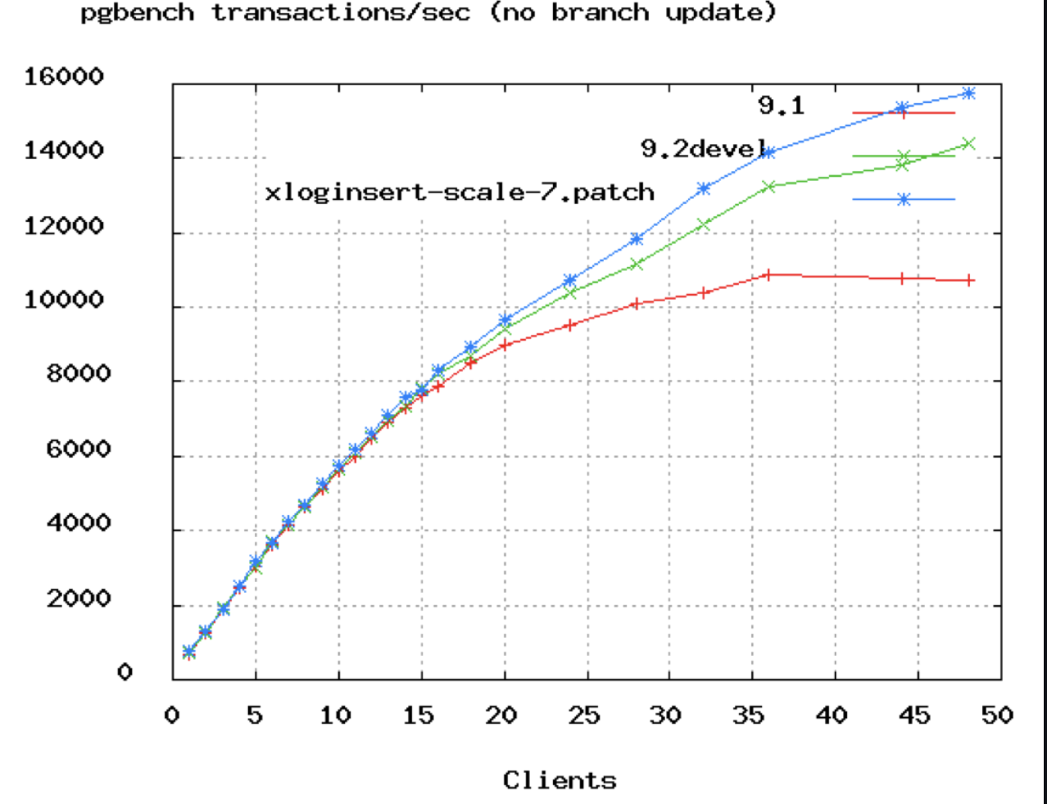
Database Connection Pool Size
https://github.com/brettwooldridge/HikariCP/wiki/About-Pool-Sizing
https://www.youtube.com/watch?v=_C77sBcAtSQ
connections =
((core_count * 2) + effective_spindle_count)
Axiom: You want a small pool, saturated with threads waiting for connections.

Slide 37
References
Web Applications: What are They? What of Them?
http://www.acunetix.com/websitesecurity/web-applications/
Web开发的发展史
https://linux.cn/article-3166-1.html
Web 研发模式演变
https://github.com/lifesinger/blog/issues/184
Java 应用一般架构
https://blog.coding.net/blog/General-architecture-for-Java-applications
The IoC Container- Bean Scopes
https://docs.spring.io/spring/docs/5.2.3.RELEASE/spring-framework-reference/core.html#beans-factory-scopes
Quick Guide to Spring Bean Scopes
https://www.baeldung.com/spring-bean-scopes
Spring注解中@Scope 的使用解说
https://blog.csdn.net/cuichunchi/article/details/79170240

Slide 38

Thank You!

